Slide 1
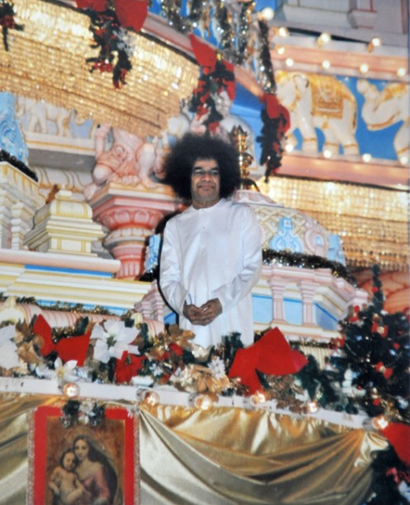
Christmas
&
Hanukkah
Celebrations!
Sri Sathya Sai Baba Center of
Central San Jose
December 21, 2014

Slide 2

Activities at Our Center
Study Circle: (3:40 to 4:40 PM @CIS) (Sun)
No SSE Next Week (Christmas break)
Service Opportunities:
Homework Enrichment Program at San Jose Family Shelter (6:15 -8:30PM) ( Mon & Wed)
Dinner Service @EHC (3:00-6:30PM)
Upcoming events
Center:New year Eve from 9:30pm-12am
Region: christmas caroling (Dec 25th Oakland) 11am-1pm
Location: Gateway Convalescent Home, 26660 Patrick Ave, Hayward, CA

Slide 3


OM (3x)
Gayathri (3x)

Slide 4
Om
Bhoorbhuvah Ssuwaha Thath Savithur Varenyam Bhargo Devasya Dheemahi Dhiyo Yonah Prachodayaath
(3x)
Om Shanthi Shanthi Shanthihi
108 Names
2 P Major

Slide 5

RADIO CSJ
108.5 FM
Notes:
5

Slide 6

Notes:
Living room with a grandma and fireplace
6

Slide 7
Sleigh bells ring, are you listenin’, In the lane, snow is glistenin’ A beautiful sight, We're happy tonight, Walkin’ in a winter wonderland. Gone away is the bluebird, Here to stay is a new bird He sings a love song, As we go along, Walkin’ in a winter wonderland. In the meadow we can build a snowman, Then pretend that he is Parson Brown He'll say: Are you married? We'll say: No man, But you can do the job When you're in town.
Continued....
C Major

Slide 8
Later on, we'll conspire, As we dream by the fire To face unafraid, The plans that we've made, Walking in a winter wonderland. In the meadow we can build a snowman, And pretend that he's a circus clown We'll have lots of fun with mister snowman, Until the other kiddies knock him down. When it snows, ain't it thrillin’, Though your nose gets a chillin’ We'll frolic and play, the Eskimo way, Walkin’ in a winter wonderland. Walkin’ in a winter wonderland, Walkin’ in a winter wonderland.
C Major

Slide 9
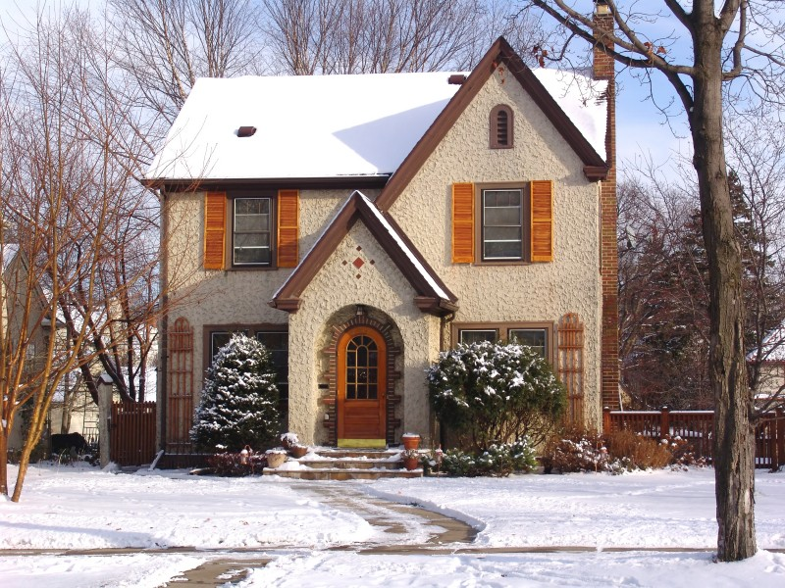

Slide 10
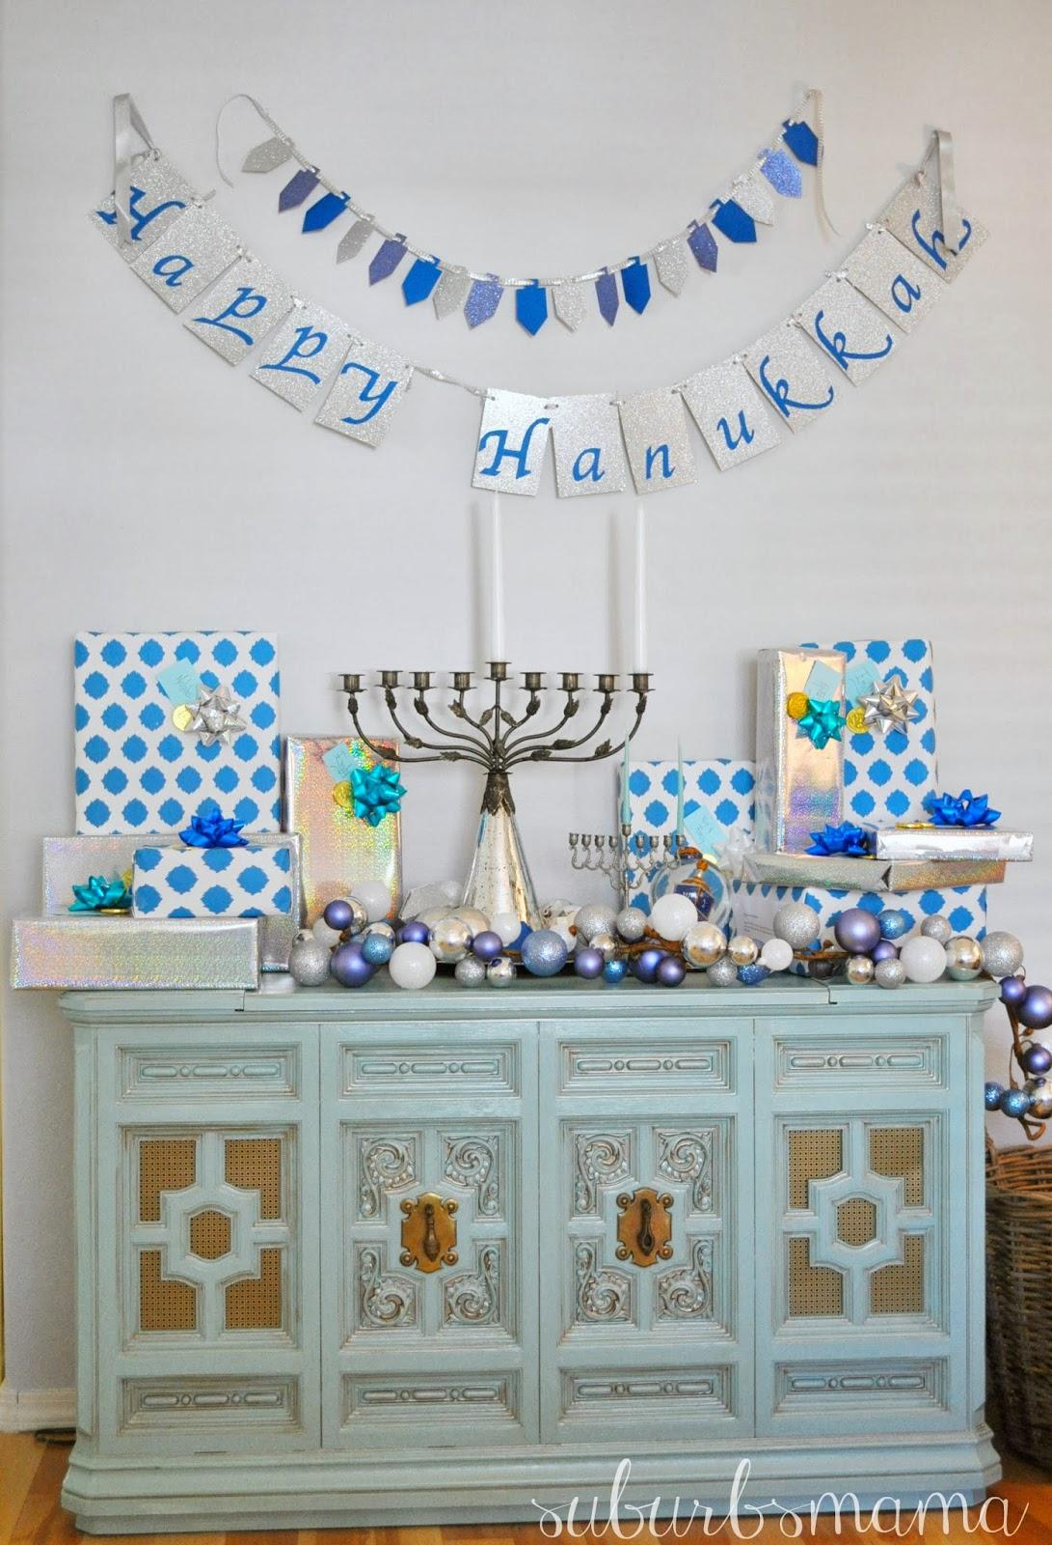
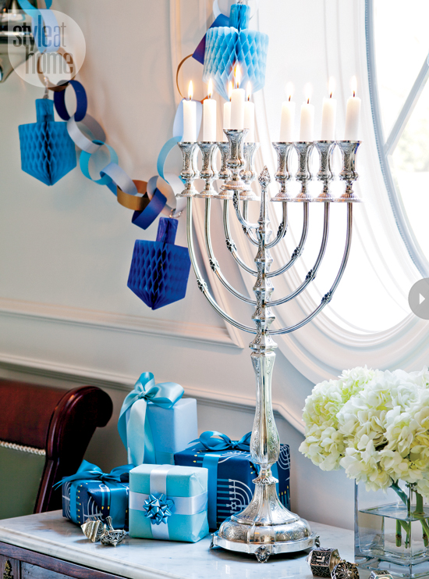
Notes:
No menorah lighting please – its confusing
10

Slide 11
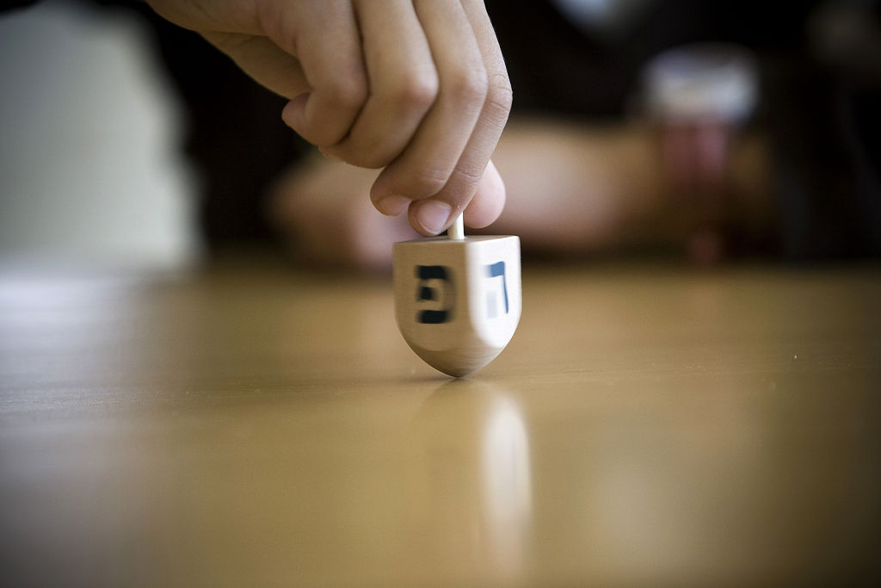
Notes:
11

Slide 12
Sevivon Sov Sov Sov Hanukkah U Ha Tov Hannukah U Ha Tov Sevivon Sov Sov Sov
Ha Sim ha U la'am Nes Gadol Aya Sham Nes Gadol Aya Sham Ha Sim ha U la'am
(3 Speeds)
Meaning:
Dreidel spin spin spin, Chanukah is a nice holiday Chanukah is a nice holiday, Dreidel spin spin spin
It's a joyous holiday for the nation, A great miracle happened there A great miracle happened there, It's a joyous holiday for the people
C# Minor
Notes:
Next slide – need picture of 2 families talking
12

Slide 14
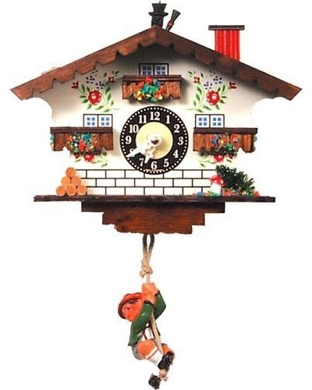
Later in the day...
...back in the Smith house

Slide 15
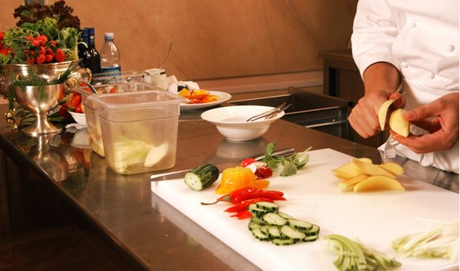

Slide 16
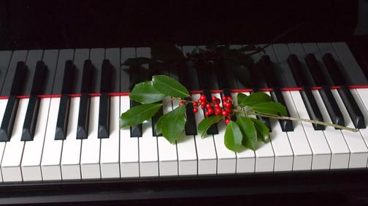

Slide 17
Joy to the world, the Lord is come!
Let earth receive her King;
Let every heart prepare Him room,
And Heaven and nature sing, (Men Echo)
And Heaven and nature sing, (Men Echo)
And Heaven, and Heaven, and nature sing.
Joy to the world, the Savior reigns!
Let men their songs employ;
While fields and floods, rocks, hills and plains
Repeat the sounding joy, (Men Echo)
Repeat the sounding joy, (Men Echo)
Repeat, repeat, the sounding joy.
Continued....
C Major
Notes:
Next slide: need family at door
17

Slide 18
He rules the world with truth and grace,
And makes the nations prove
The glories of His righteousness,
And wonders of His love, (Men Echo)
And wonders of His love, (Men Echo)
And wonders, wonders, of His love. (Up)
C Major
Notes:
Next slide: need family at door
18

Slide 19
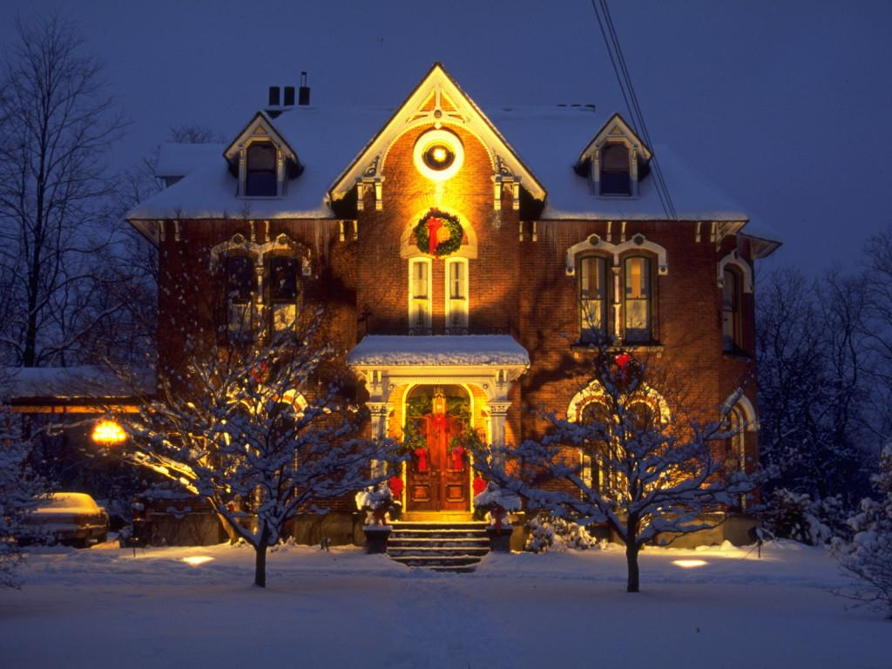

Slide 20
Hevenu Shalom Aleicham (3x)
Hevenu Shalom Shalom Shalom Aleicham
4 Speeds (End up)
Meaning: We wish peace to/upon you
C# Minor

Slide 22
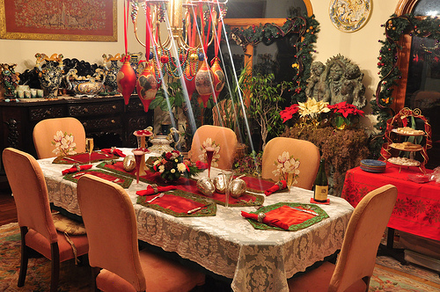
Notes:
Need cooking slide not food slide
22

Slide 23
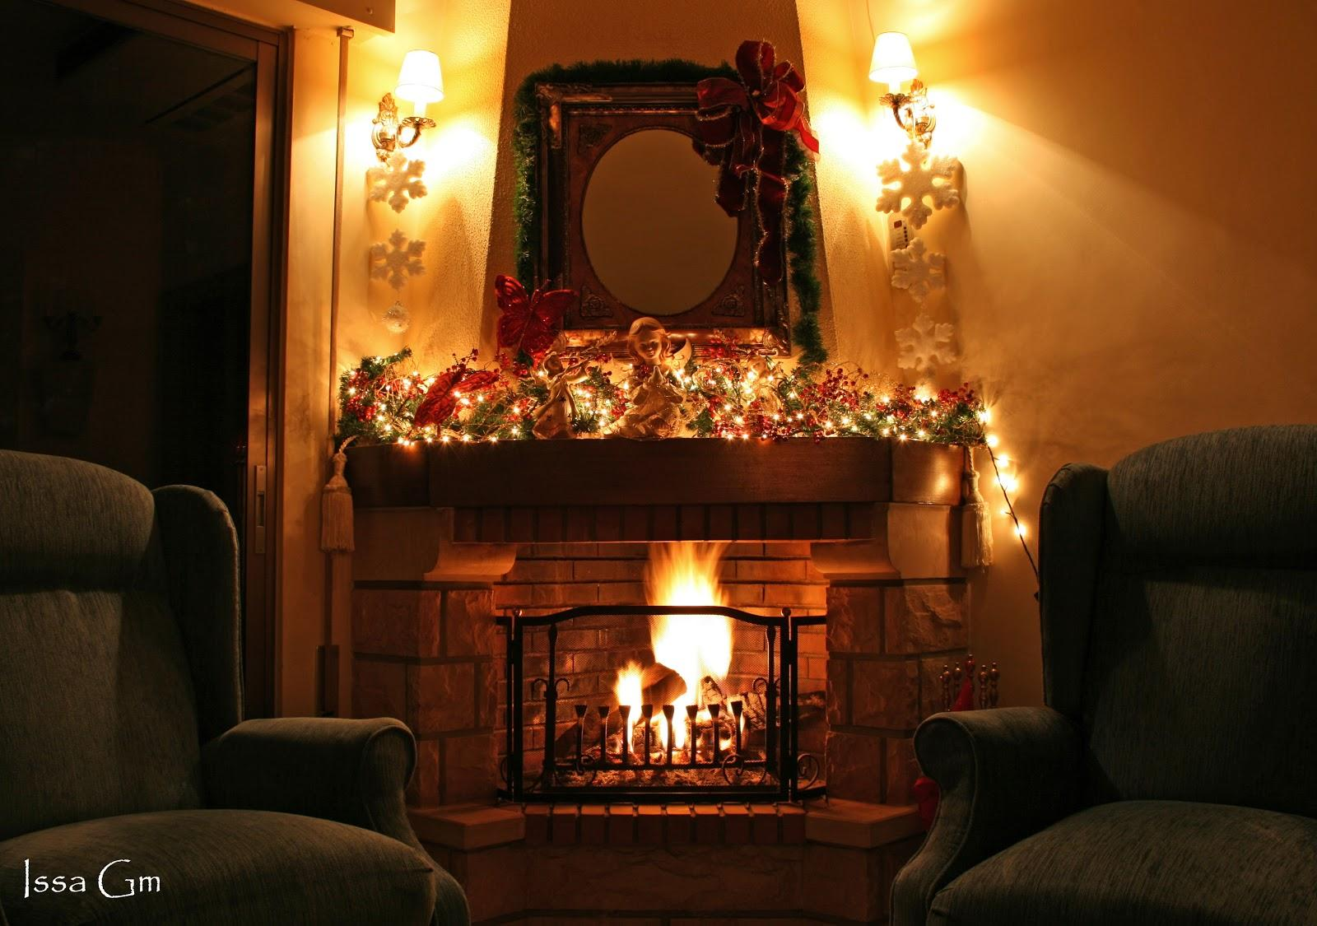
Notes:
Grandma needed
23

Slide 24
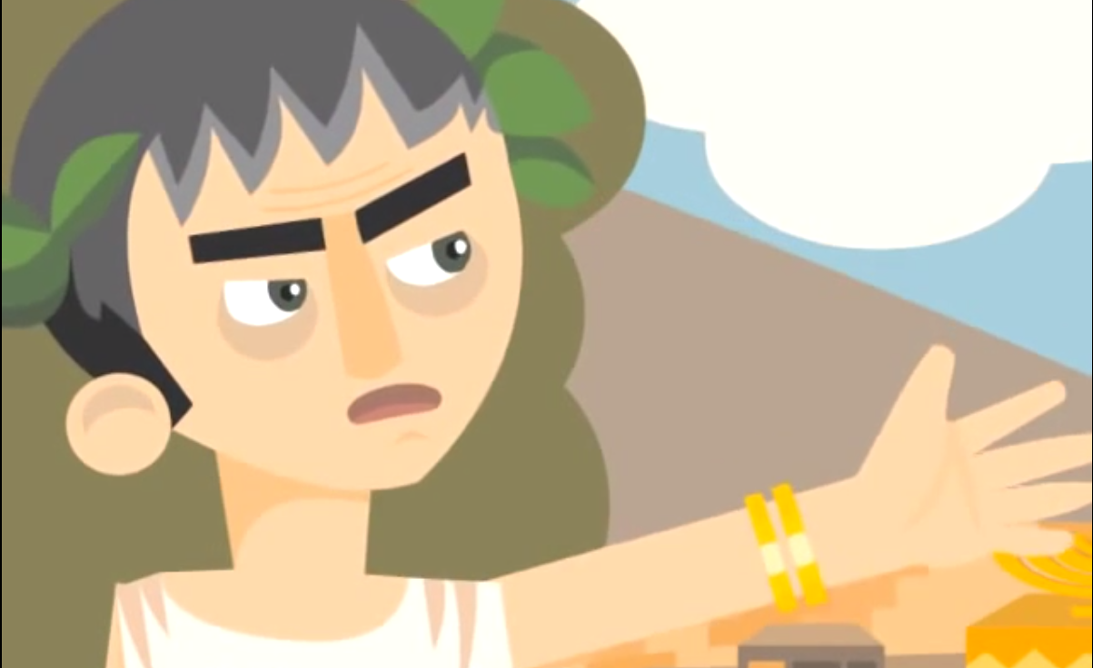

Slide 25
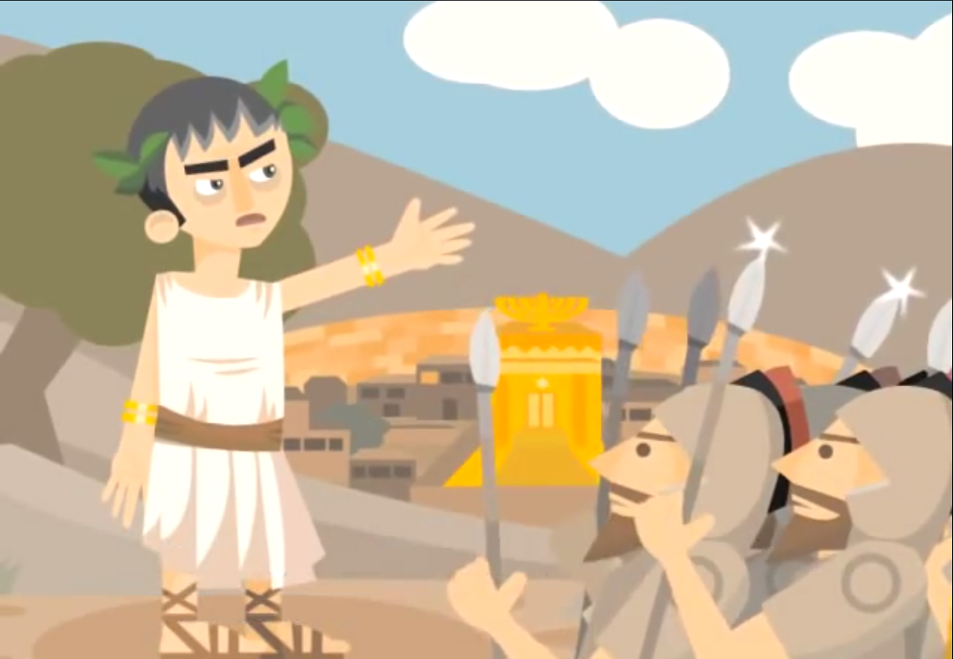

Slide 26
Shalu Shalom Yerushalayim (4x)
Pray for the peace of Israel
Pray for the peace of Ishmael
Pray for the peace of all the worlds
That all the world shall live in peace
Shalom Shalom (3x)
Shalu Shalom Yerushalayim
(2x)
Continued....
C Minor

Slide 27
Fast:
Shalu Shalom Yerushalayim (4x)
Pray for the peace of Israel
Pray for the peace of Ishmael
Pray for the peace of all the worlds
That all the world shall live in peace
Shalom Shalom (3x)
Shalu Shalom Yerushalayim
(2x)

Slide 28
Notes:
Grandma needed
28

Slide 29
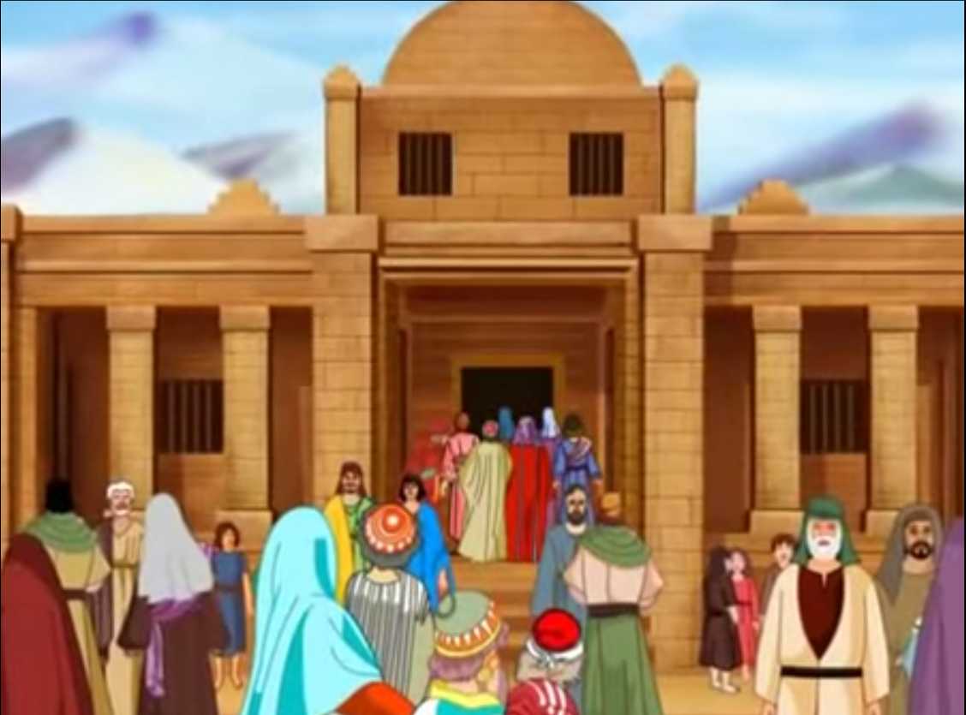

Slide 30
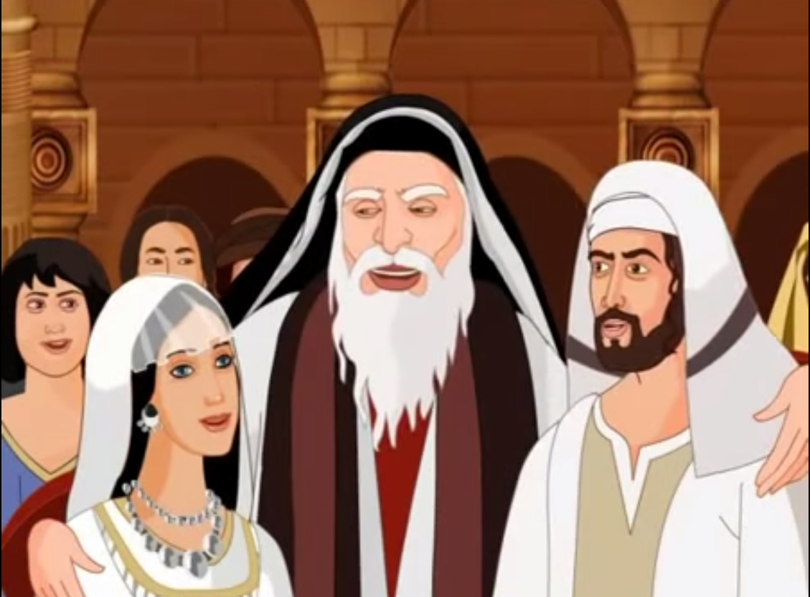

Slide 31
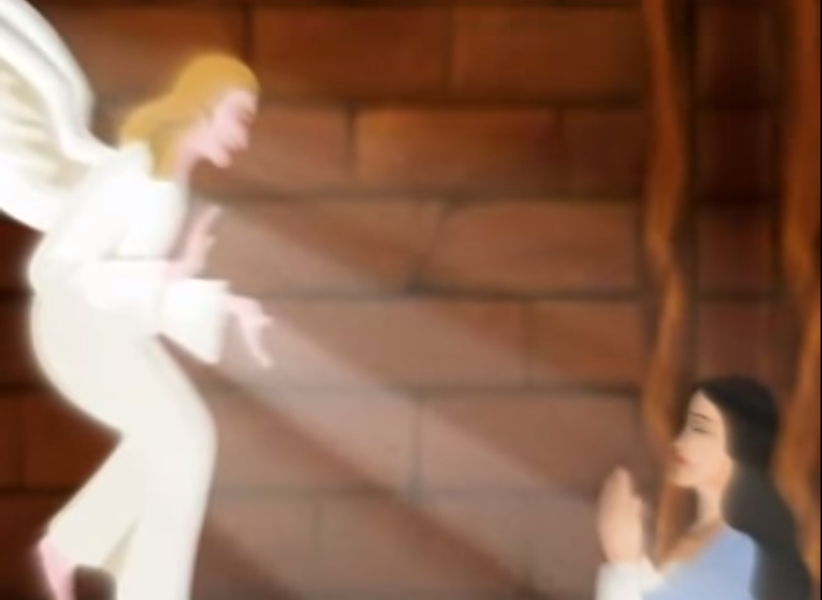

Slide 32
Holy Mary Mother of Love
Holy Mary Teach us Devotion and Love
(1x Low, 1x High)
C Minor

Slide 33
Notes:
Grandma needed
33

Slide 34
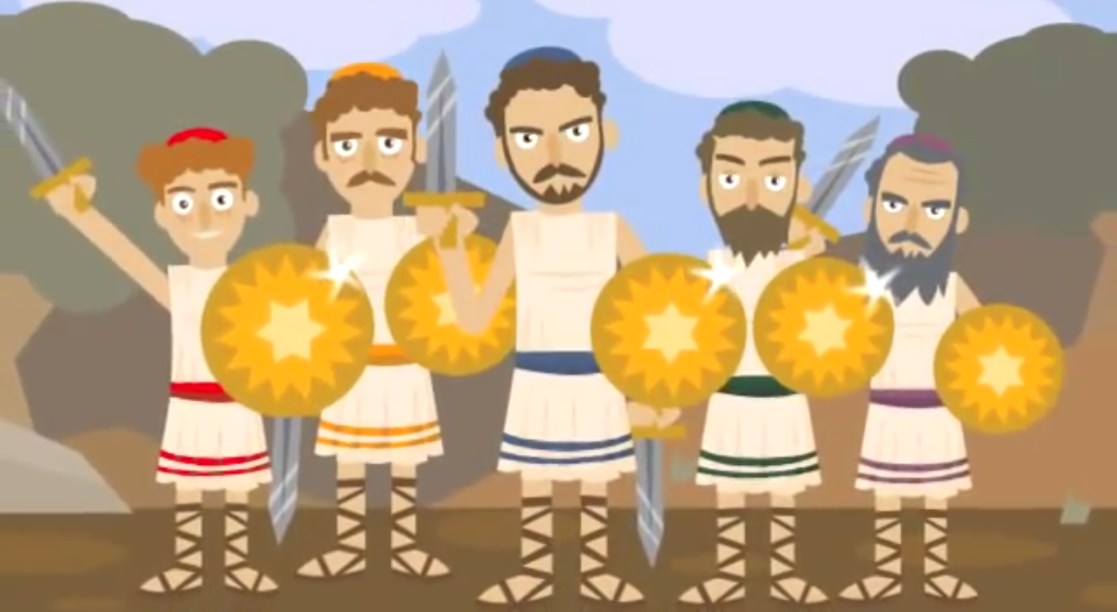

Slide 35
Ev du hashem ba sim ha (4x)
Come and serve the holy one with joy (4x)
Yai dai da dai dai Yai dai da dai dai dai
Yai dai da dai dai Yai dai dai
Yai dai da dai dai Yai dai da dai dai dai
Yaiii da dai dai dai dai dai
Continued....
D Minor

Slide 36
Fast:
Ev du hashem ba sim ha (4x)
Come and serve the holy one with joy (4x)
Yai dai da dai dai Yai dai da dai dai dai
Yai dai da dai dai Yai dai dai
Yai dai da dai dai Yai dai da dai dai dai
Yaiii da dai dai dai dai dai
(2x)
Slow: Ev du hashem ba sim ha (4x)

Slide 37
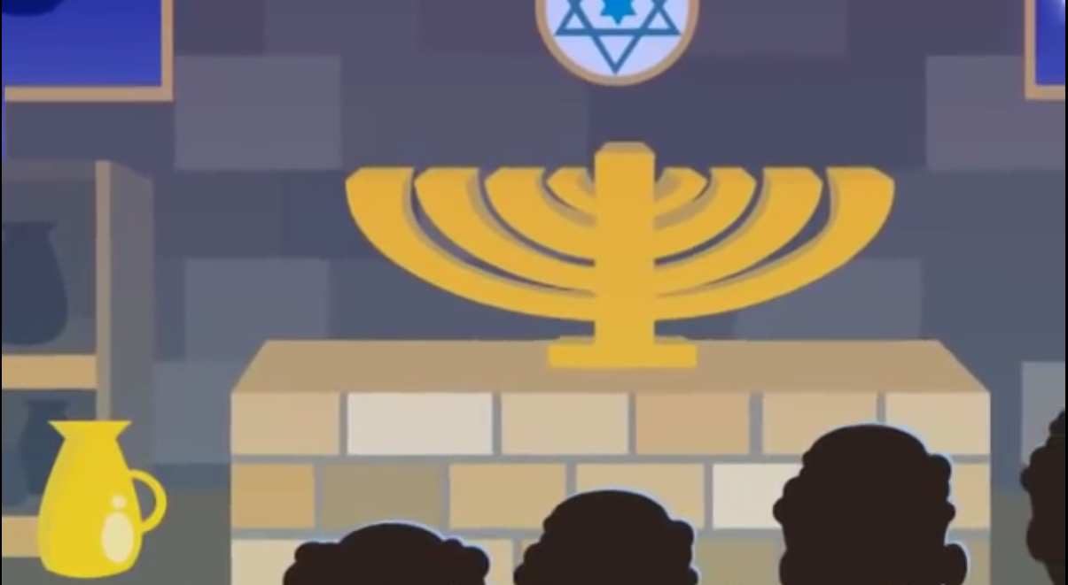

Slide 38
Notes:
Grandma needed
38

Slide 39
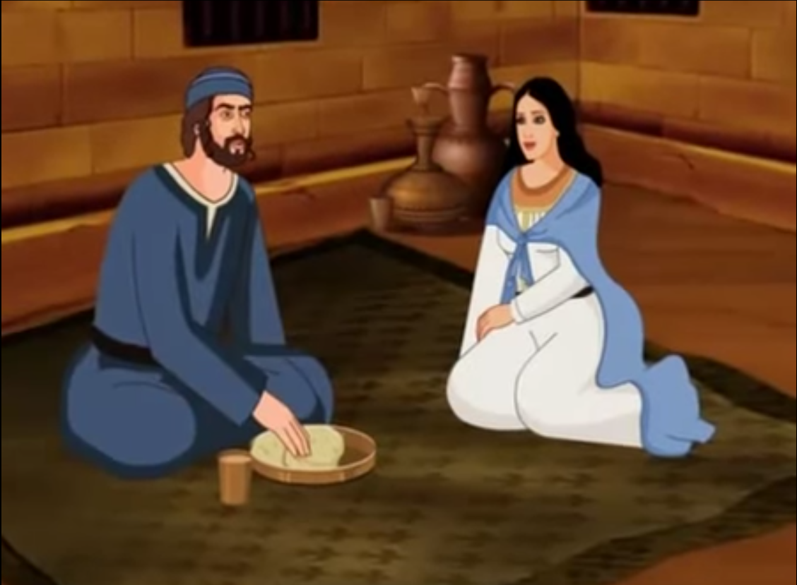

Slide 40
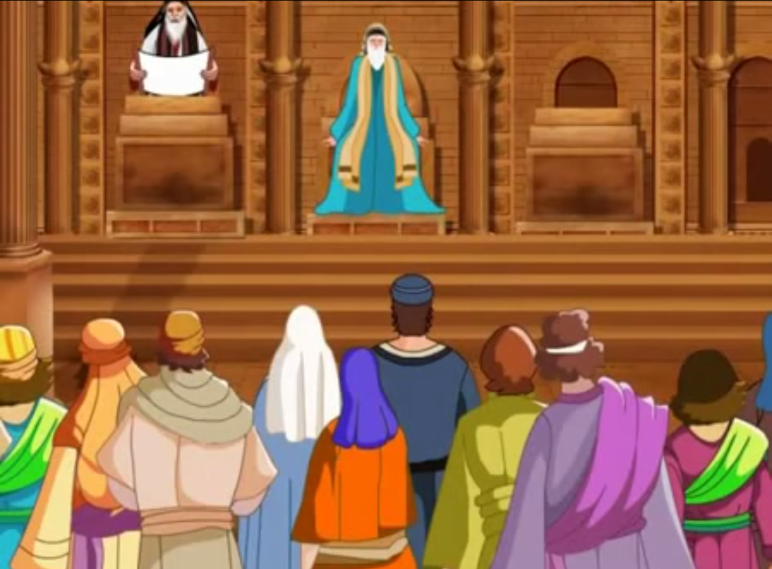

Slide 41
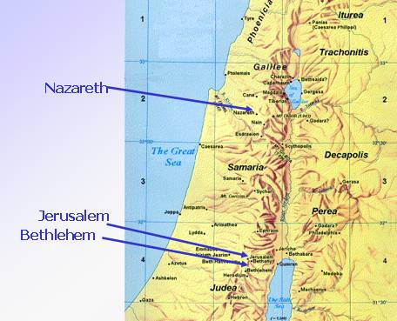

Slide 42
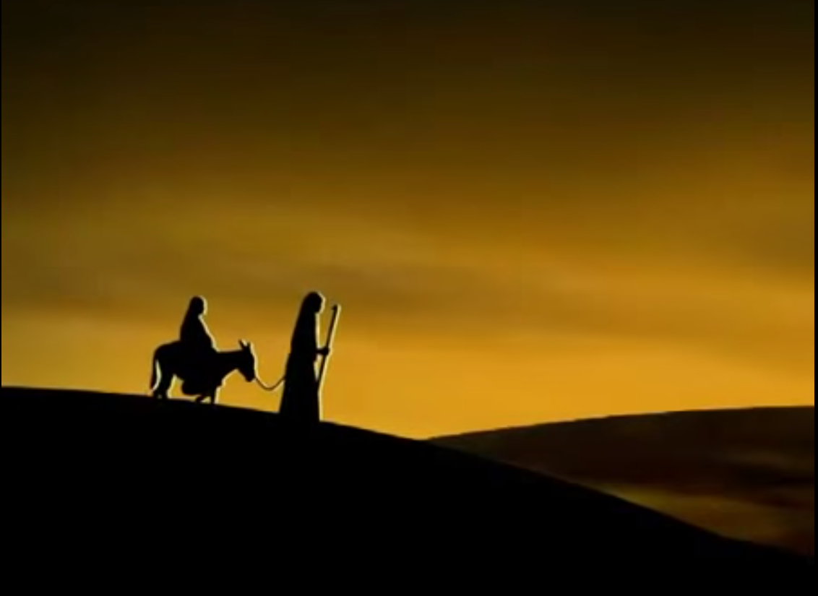

Slide 43
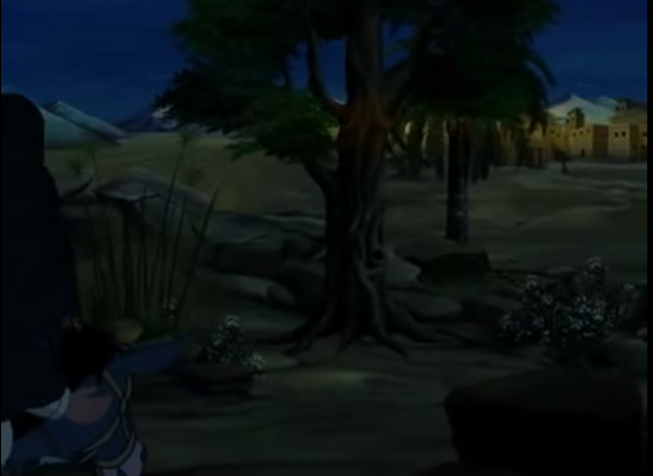

Slide 44
The First Noel The First Noel, the Angels did say Was to certain poor shepherds in fields as they lay In fields where they lay keeping their sheep On a cold winter's night that was so deep. Noel, Noel, Noel, Noel Born is the King of Israel! They look-ed up and sa-aw a star Shining i-in the East be-yond them far And to-o the earth it gave great light And so it continued both day and night. Noel, Noel, Noel, Noel Born is the King of Israel!
Continued....
G# Major

Slide 45
And by the light of tha-at same star Three Wi-ise men ca-ame from cou-ountry far To se-ek for a King was the-eir intent And to follow the sta-ar wherever it went. Noel, Noel, Noel, Noel (up) Born is the King of Israel!

Slide 46
Notes:
Grandma needed
46

Slide 48
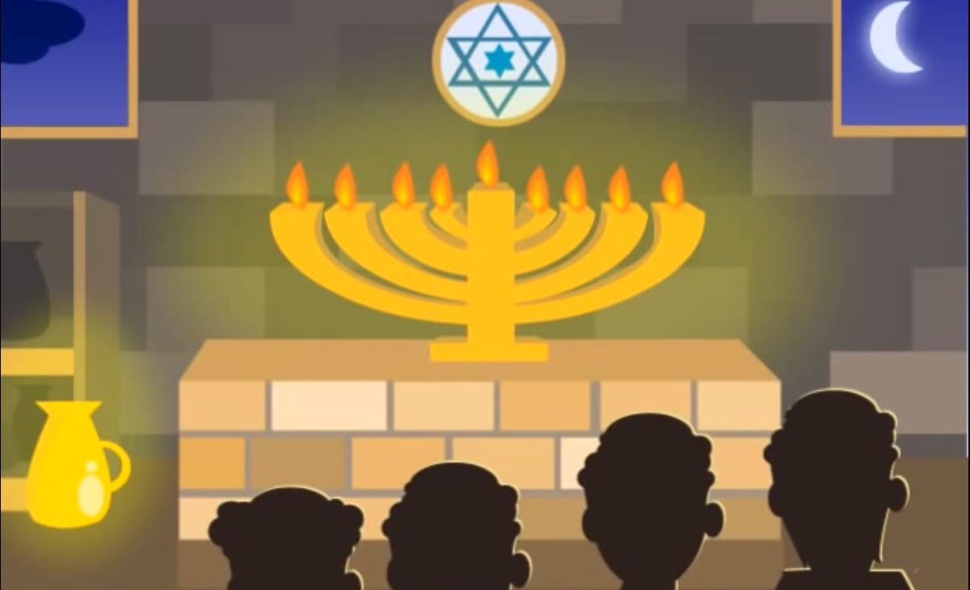

Slide 49
Notes:
Grandma needed
49

Slide 50
Hava nagila, hava nagila Hava nagila ve-nis'meha (2x) Hava neranena, hava neranena Hava neranena venis'meha (2x) Uru, uru ahim Ur ahim belev same'ah (2x)
Ur ahim belev same'ah (2x - higher)
Ur ahim ur ahim (2 beats) belev same'ah
Let us rejoice, let us rejoice, Let us rejoice and be glad; Let us sing, let us sing, Let us sing and be glad; Awaken, awaken brethren, Awaken brethren with a cheerful heart.
Continued....
C Major
Notes:
Let us rejoice, let us rejoice Let us rejoice and be glad Repeat Let us sing, let us sing Let us sing and be glad Awaken, awaken brethren Awaken brethren with a cheerful heart.
50

Slide 51
(Fast)
Hava nagila, hava nagila Hava nagila ve-nis'meha Hava neranena, hava neranena Hava neranena venis'meha
Uru, uru ahim Ur ahim belev same'ah (2x)
Ur ahim belev same'ah (2x - higher)
Ur ahim ur ahim (2 beats) belev same'ah
Let us rejoice, let us rejoice, Let us rejoice and be glad; Let us sing, let us sing, Let us sing and be glad; Awaken, awaken brethren, Awaken brethren with a cheerful heart.
C Major
Notes:
Let us rejoice, let us rejoice Let us rejoice and be glad Repeat Let us sing, let us sing Let us sing and be glad Awaken, awaken brethren Awaken brethren with a cheerful heart.
51

Slide 52
Notes:
Grandma needed
52

Slide 53
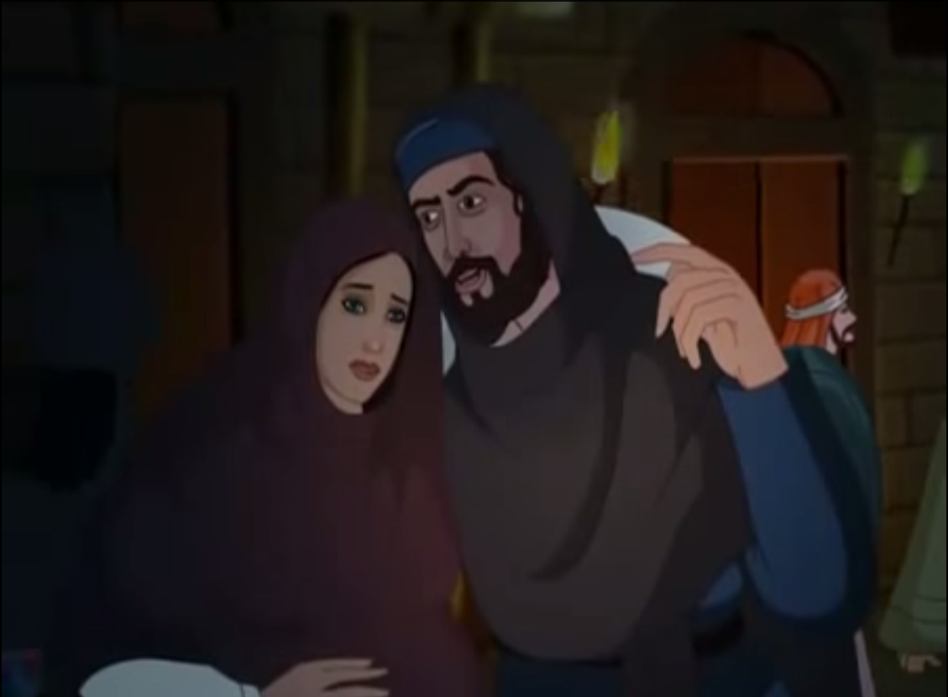

Slide 54
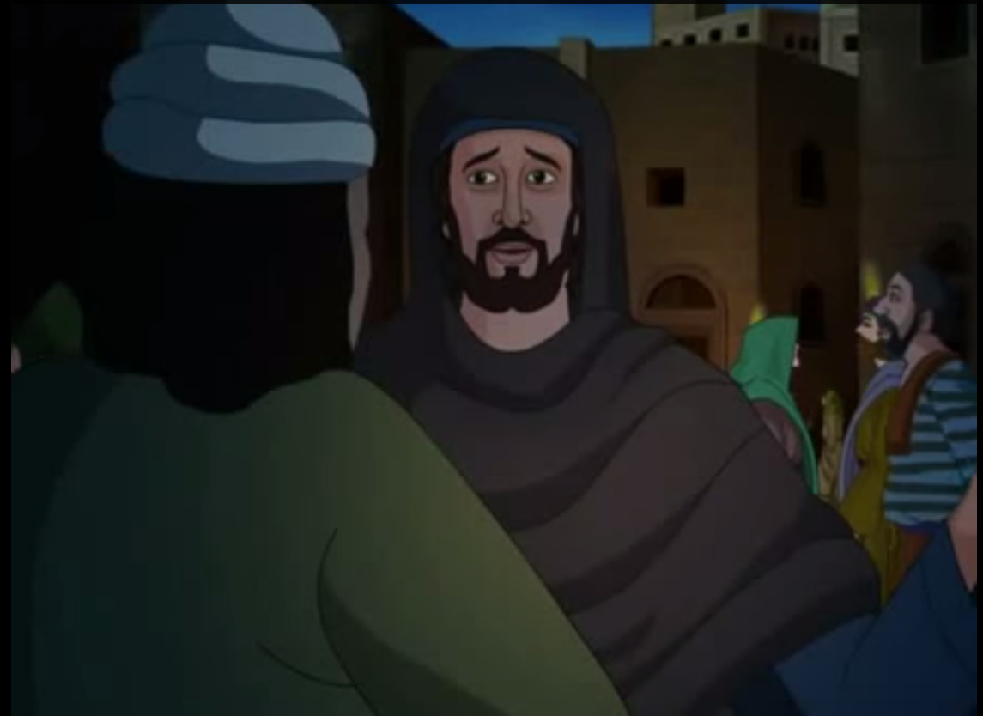

Slide 55
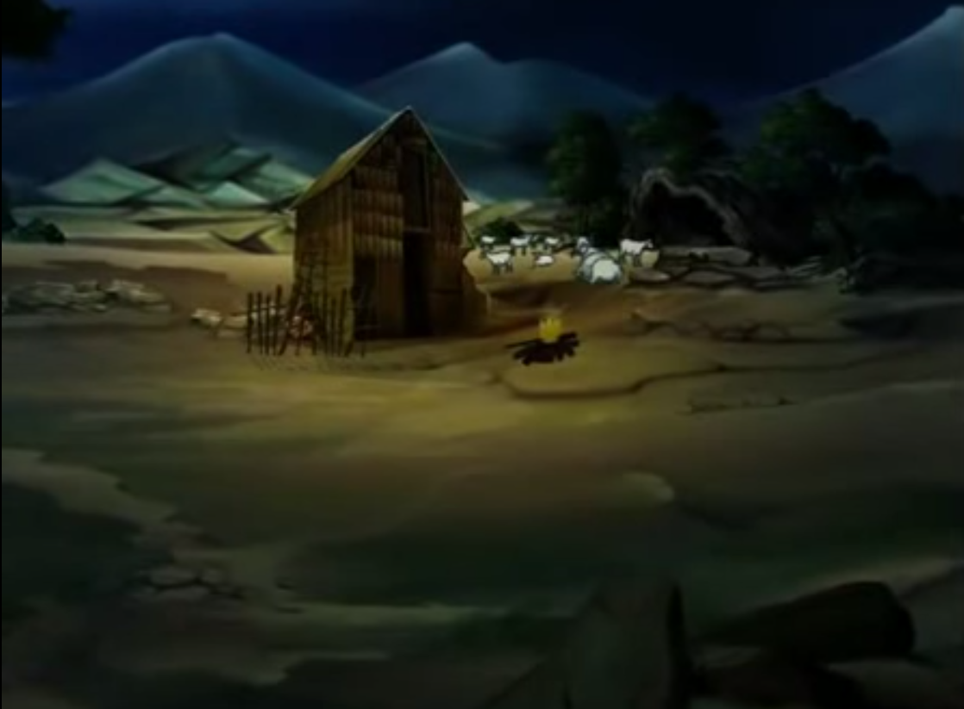

Slide 56
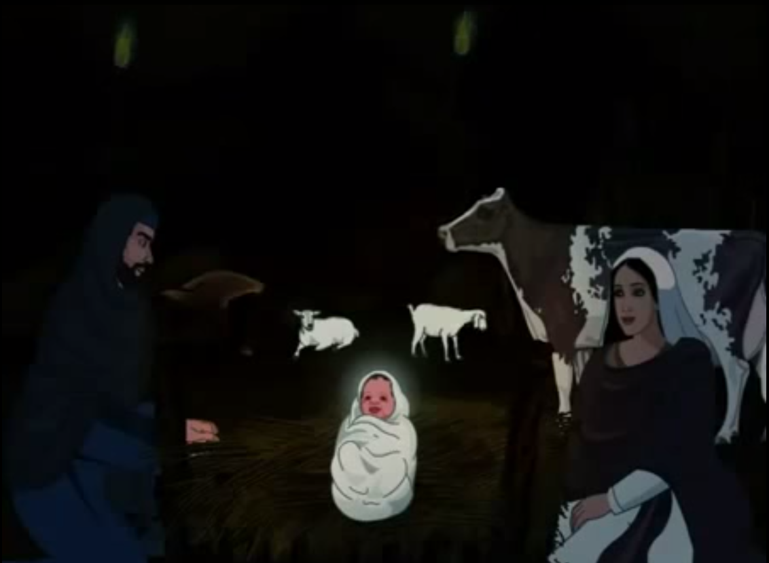

Slide 57
Hark the herald angels sing
"Glory to the newborn King!
Peace on earth and mercy mild
God and sinners reconciled"
Joyful, all ye nations rise
Join the triumph of the skies
With the angelic host proclaim:
"Christ is born in Bethlehem"
Hark! The herald angels sing
"Glory to the newborn King!“ (Up)
Continued....
D Major

Slide 58
Christ by highest heav'n adored
Christ the everlasting Lord!
Late in time behold Him come
Offspring of the favored one
Veiled in flesh the Godhead see
Hail the incarnate Deity
Pleased as man with man to dwell
Jesus, our Emmanuel
Hark! The herald angels sing
"Glory to the newborn King!“ (Up)
Continued....

Slide 59
Hail the heav'n-born Prince of Peace!
Hail the Son of Righteousness!
Light and life to all He brings
Ris'n with healing in His wings
Mild He lays His glory by
Born that man no more may die
Born to raise the sons of earth
Born to give them second birth
Hark! The herald angels sing
"Glory to the newborn King!“ (Up)
Hark! The herald angels sing
Slow: "Glory to the newborn King!“ (Down)

Slide 60
Notes:
Grandma needed
60

Slide 61
You better watch out You better not cry Better not pout I'm telling you why Santa Claus is coming to town
He's making a list, He’s checking it twice; He’s gonna find out who's naughty or nice. Santa Claus is coming to town (3x)
Continued....
A Major

Slide 62
He sees you when you're sleeping! He knows when you're awake! He knows if you've been bad or good! So be good for goodness sake! O! You better watch out! You better not cry. Better not pout, I'm telling you why. Santa Claus is coming to town.
You better watch out! You better not cry. Better not pout, I'm tellin’ you why. Santa Claus is comin’ to town (3x)

Slide 63
Lai lai laa (4x –Men start, alternate)
(1x – Men, 1x – Women)
Hanukkah, Oh Hanukkah, Come light the menorah Hanukkah, Oh Hanukkah, Come light the menorah Gather 'round the table and lets have a treat Happy songs we’ll sing and latkes we’ll eat
(All) And while we are singing The candles are burning bright One for each night, they shed a sweet light and remind us of days long ago (Up) One for each night, they shed a sweet light and remind us of days long ago (Down)
Continued....
C Minor

Slide 64
Lai lai lai (4x – Women start, alternate)
(1x – Women, 1x – Men )
Hanukkah, Oh Hanukkah, A festival of joy
A holiday, a jolly day, For every girl and boy
Gather 'round the table and lets have a treat
Happy songs we’ll sing and latkes we’ll eat
And while we are singing
We’ll think of those days long ago
And then we’ll tell the story of the miracles, glory
And dance by the candles burning low (Up)
And then we’ll tell the story of the miracles, glory
And dance by the candles burning low (Down)
Lai lai lai (4x – Women start, alternate) Laaaai

Slide 65
(1x Slow, 1x Fast)
We wish you a Merry Christmas,
We wish you a Merry Christmas,
We wish you a Merry Christmas and a Happy Hanukkah
(2x)
Good tidings we bring to you and your kin;
Good tidings for Christmas and a Happy Hanukkah
(2x)
Continued....
G Major

Slide 66
(Fast)
We wish you a Merry Christmas,
We wish you a Merry Christmas,
We wish you a Merry Christmas and a Happy Hanukkah
Good tidings we bring to you and your kin;
Good tidings for Christmas and a Happy Hanukkah
Slow: Good tidings for Christmas and a Happy Hanukkah
G Major

Slide 67
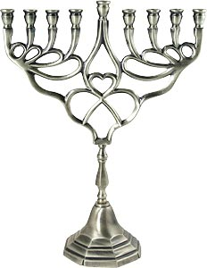
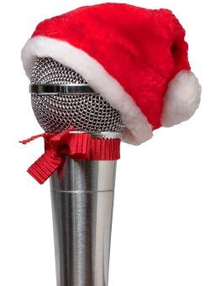
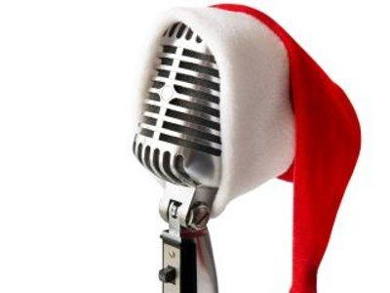
RADIO CSJ
108.5 FM

Slide 68
UNISON
Om Tatsat Sri Narayana Tu, Purushottama Guru Tu
Siddha Buddha Tu, Skanda Vinayaka,
Savita Pavaka Tu
Brahma Mazda Tu, Yehova Shakti Tu, Yesu Pita Prabhu Tu
Rudra Vishnu Tu, Ramakrishna Tu, Rahima Tao Tu
Vasudeva Go-Vishwarupa Tu, Chidananda Hari Tu
Advitiya Tu, Akala Nirbhaya Atmalinga Shiva Tu
Sai Gayathri (3x)

Slide 69
UNISON
Om Sayishwaraya Vidmahe Sathya Devaya Dheemahi
Tanna Sarva Prachodayaath (x3)
Om Shanthi Shanthi
Shantihi
All Praise to you Lord

Slide 70

UNISON
All praise to You Lord of the Worlds
Swami Sathya Sai Our Lord
You protect devotees who cling to You
Show Your Mercy to us who sing to You
Knowing You are God in human form
All praise to You Lord of the Worlds
With captivating…..

Slide 71
UNISON
With captivating grace and loveliness
You do everything to bring us happiness
You're aware of all through infinite consciousness
You are Master of every living thing
For devotees You're wish-fulfilling
Helping us when we are in distress
All praise to You Lord of the Worlds
Mother Father …..

Slide 72
UNISON
Mother Father Teacher and Lord
You remind us there is only one not two
Swami there is truly no one else but You
Master of creation You are adored
People of all nations are striving toward
Realization of our true reward
Our unity with You Lord of the Worlds
You are the word…..

Slide 73
UNISON
You are the Word of God pure and bright
The Embodiment of all that’s true and right
Sathya Sai fill our hearts with pure delight
Do accept our prayer and heed us
From darkness we can't bear please lead us
With your might You make our burdens light
All praise to You Lord of the Worlds
Om Jaya Jagadeesa …..

Slide 74
UNISON
Om Jaya Jagadeesa Harey
Swami Sathya Sai Harey
Bhaktha Jana Samrakshaka (2x)
Parthi Maheshwara
Om Jaya Jagadeesa Harey
Victory to Lord of the Universe, Lord Sathya Sai, Who destroys grief, evil and miseries of life and Who guards and protects devotees. Victory to Lord of Lords - Lord of Parthi!
Sashi Vadana…..

Slide 75
UNISON
Sashi Vadana Sree Karaa
Sarva Praana Pathey, Swami Sarva Prana Pathe
Aasritha Kalpalatheeka (2x)
Aapadh Baandhavaa
Om Jaya Jagadeesa Harey
O Graceful and Charming as a Full Moon ! O Auspicious One ! O Lord Sai! Thou art: the Indweller and Life-force of all Beings; the wish- fulfilling Divine creeper to those who have surrendered to Thee; and kinsman, protector and friend in times of distress and calamities. Victory to the Lord of the Universe.
Matha Pitha…..

Slide 76
UNISON
Maatha Pitha Guru Daivamu
Mari Anthayu Neevey , Swami Mari Anthayu Neevey
Naadabrahma Jagannaatha (2x)
Naagendra Shayanaa
Om Jaya Jagadeesa Harey
Victory to Lord of the Universe, Lord Sathya Sai, Who destroys grief, evil and miseries of life and Who guards and protects devotees. Victory to Lord of Lords - Lord of Parthi!
Omkaara Roopa…..

Slide 77
UNISON
Omkaara Roopa Ojaswi O Saayi Mahadeva
Sathya Saayi Mahadeva
Mangala (H)Aarathi Anduko (2x)
Mandhara Giridhari
Om Jaya Jagadeesa Harey
O Splendorous One ! O Lord of Lords - Lord Sai Thou Form is Pranava. We pray Thee to accept the auspicious waving of flame of light (signifying the removal of ignorance). Victory to Thee, O Lord of the Universe, O Lord Giridhari who lifted the Mandhar mountain.
Narayana Narayana..

Slide 78
UNISON
Narayana Narayana Om
Sathya Narayana Narayana Narayana Om
Narayana Narayana Om
Sathya Narayana Narayana Om
Sathya Narayana Narayana Om
Om Jaya Sathguru Devaa (x3)
Om Shanthi Shanthi Shantihi!
Chant the name of Lord Sathya Sai Narayana, Whose Form is Pranava (Om). Victory to Noble Teacher and Supreme Lord Sai, Sathya Sai.
Sacred Holy and Supreme..

Slide 79
UNISON
Sacred, holy and Supreme is Baba’s vibhuti
Pouring forth in brilliant stream – this play of vibhuti
So auspicious is its might, it grants liberation
Baba’s vibhuti – its power protects me.
Paramam Pavithram Baba Vibhuthim
Paramam Vichithram Leela Vibhuthim
Paramaartha Ishtaartha Moksha Pradhaatham
Baba Vibhuthim Idhamasrayami
I take refuge in the supremely sacred Vibhuthi of Lord Baba, the wonderful Vibhuti, which bestows salvation, the sacred state which I desire to attain.
Divine Code of Conduct....

Slide 80
Divine Code of Conduct # 8
Not speaking ill of others, especially in their absence.
Thought for the week

Slide 81
Thought for the week
There is no compulsive rule that incarnations should occur only on the earth and in human form. Any place and any form can be chosen by the fully free. Whichever place and form promote the purpose of fulfilling the yearning of the devotee, that place and form are chosen by the will of God. God is above and beyond the limits of time and space. He is beyond all characteristics and qualities, and no list of such can describe Him fully. For Him, all beings are equal. The difference between man, beast, bird, worm, insect, and even a god is but a difference of the ‘vessel’ (upadhi). The one single God activates every vessel and gives rise to manifold consequences. God appreciates the consciousness of unity as the basic motive of acts. He doesn’t appreciate the activity itself being one without variety; activity must be suited to the various needs. - Bhagavatha Vahini, Ch 1, 'The Bhagavatha'.
From Untruth……

Slide 82
UNISON
From untruth, lead us to Truth
From the darkness, lead us to the Light
From death, to immortality
Asatoma Sadgamaya
Tamasoma Jyotirgamaya
Mrityorma Amritangamaya
Om Shanti Shanti Shantihi
May all the beings

Slide 83
UNISON
May All The Beings In All The Worlds Have Happiness And Peace.
Samastha Lokah
Sukhino Bhavantu (3X)
Om Shanti Shanti Shantihi!
Meditation……

Slide 84
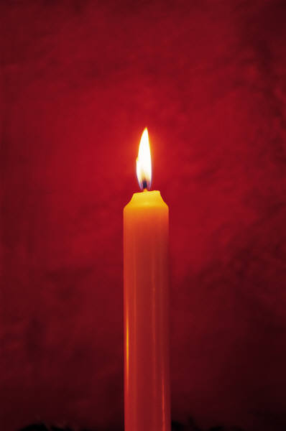
Meditation
Silent Departure……

Slide 85
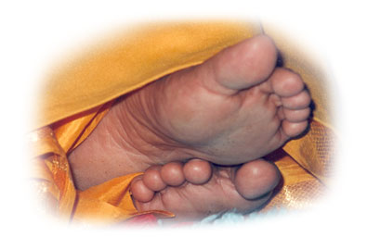
AT YOUR DIVINE LOTUS FEET

